Slide 1
Food for Thought
A Comparative Analysis of Restaurant Ratings vs. Risk Scores

Slide 2
Group Three Team Members
Austin Reed
Brenna Kelly
Liz Gomez
Pamela Fernandez
Emma Dublin

Slide 3
Objectives
Our inspiration
The search for data
How we cleaned and prepared the data
The analysis process for our data
Conclusion
Resources utilized (Appendix)

Slide 4


Our Inspiration
VS.
Customer Reviews
Health Inspection Ratings
Notes:
We began our brainstorming session by discussing ideas about potential correlations and large available datasets. Food reviews was suggested so we looked for ways to contrast or compare customer reviews- as there seemed to be many platforms for customers to provide ratings and reviews.

Slide 5


Data Preparation Overview
Google API – JSON
Google Restaurant Reviews
The type of transformation needed for this data
Cleaning
Joining
Filtering
Aggregating
This Photo by Unknown Author is licensed under CC BY-SA
Google API
Set up parameters for hot dogs
Load results to a database
Use the page token to get 60 results per search (rather than 20)
Loop through three more parameters – hamburgers, tacos, pizza
Drop any results that were not in Chicago and drop any duplicate restaurants
CDP – Food Inspections
2010 through 2/2022 inspections data
Deleted all but the last 5 years of data
Deleted results for restaurants that are out of business
Chicago Data Portal – CSV
Food Inspection Ratings
Notes:
Types of data: The sources of data that proved the most accurate, and had the ability to match/link data objects:
Google API - JSON
Google Restaurant Reviews
Chicago Data Portal – CSV
Food Inspections
The industry review or ratings sites all charge for data, and some of the larger customer review sites have very limited datasets or extremely strict usage terms.

Slide 6

Data Source Identification
This Photo by Unknown Author is licensed under CC BY-SA
Google API – JSON
Google Restaurant Reviews
Chicago Data Portal – CSV
Food Inspection Ratings
Notes:
Types of data: The sources of data that proved the most accurate, and had the ability to match/link data objects:
Google API - JSON
Google Restaurant Reviews
Chicago Data Portal – CSV
Food Inspections
The industry review or ratings sites all charge for data, and some of the larger customer review sites have very limited datasets or extremely strict usage terms. It took a while to find the right ones for what we wanted- large datasets, free use, matching data objects for location/address, etc.
We also

Slide 7
Data Cleaning and Filtering
Google API
Set up parameters for hot dogs
Load results to a database
Use the page token to get 60 results per search (rather than 20)
Loop through three more parameters – hamburgers, tacos, pizza
Drop any results that were not in Chicago and drop any duplicate restaurants
CDP – Food Inspections
2010 through 2/2022 inspections data
Deleted all but the last 5 years of data
Deleted results for restaurants that are out of business

Slide 8
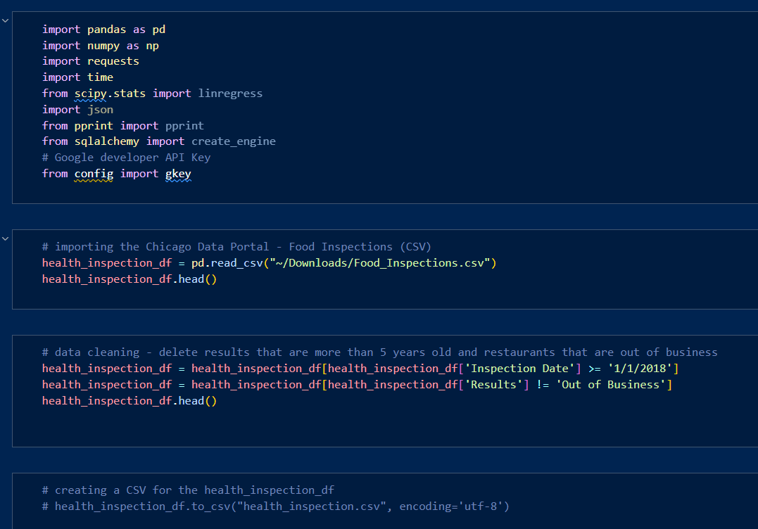
Data Cleaning and Filtering

Slide 9
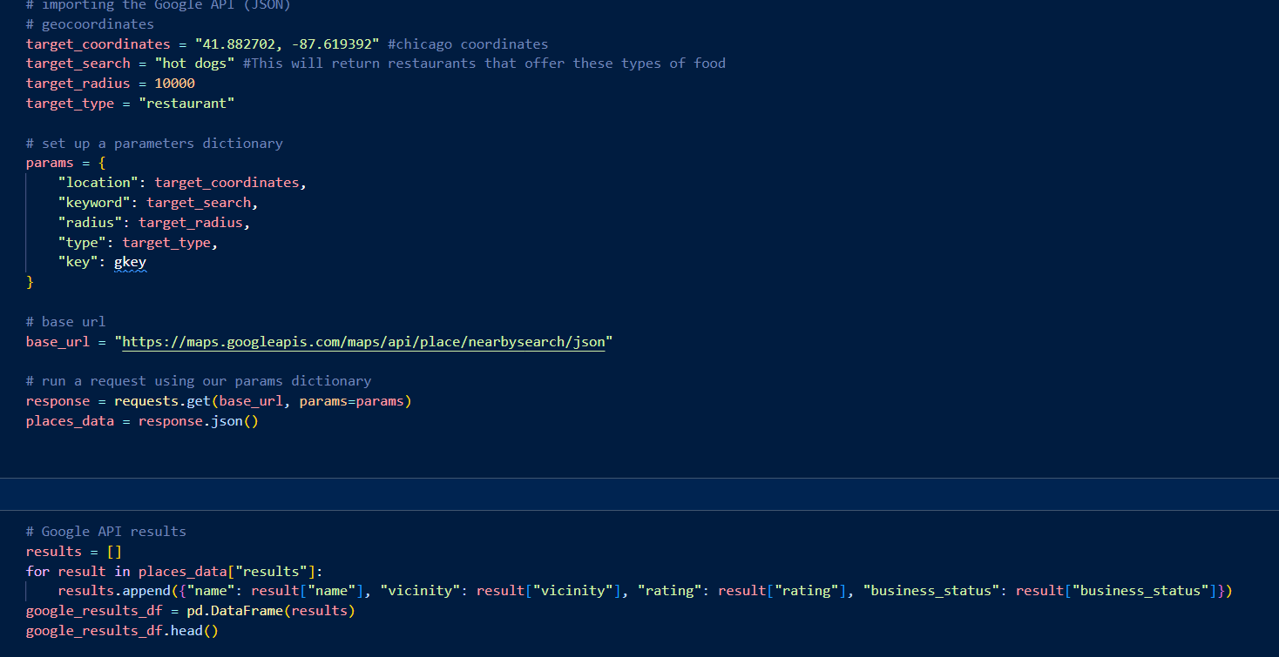
Data Cleaning and Filtering

Slide 10
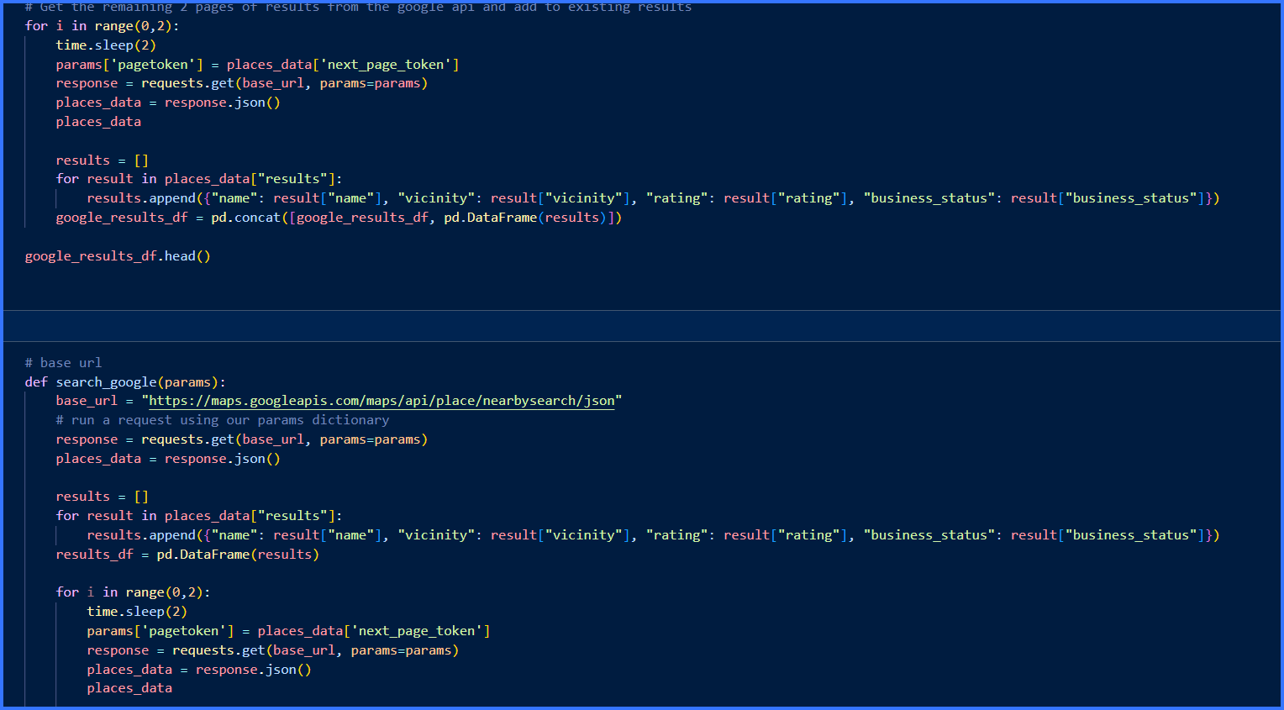
Data Cleaning and Filtering

Slide 11
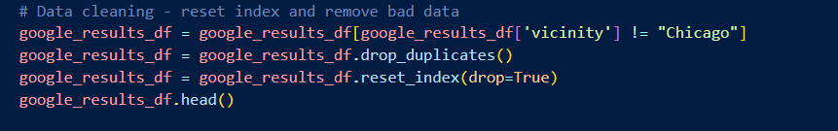
Data Cleaning and Filtering

Slide 12
Joining Our Data Sources
We created a new dataset that joined all the elements of the Food Inspection dataset with the ratings and business status of the Google dataset that met our parameters.
To make this work we split the Google addresses on the comma and made it all uppercase to match the Food Inspection dataset
Capitalizing for better matching
Stripping the city from address to match datasets

Slide 13
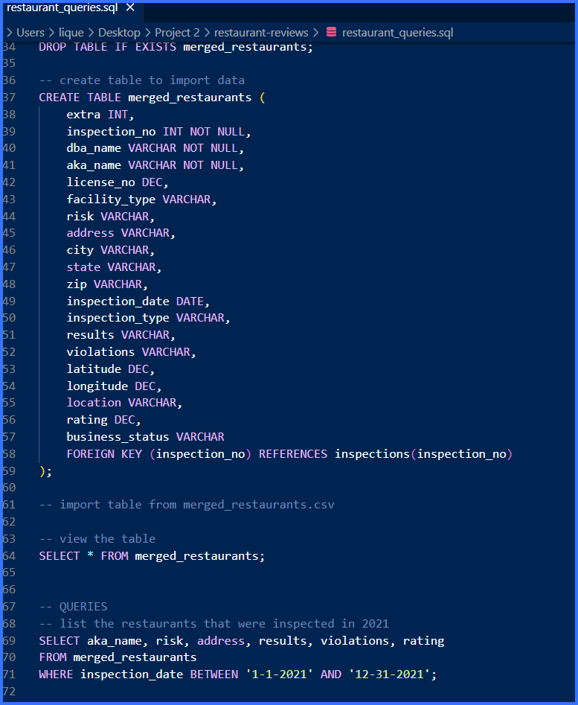
Joining Our Data Sources (cont.)

Slide 14
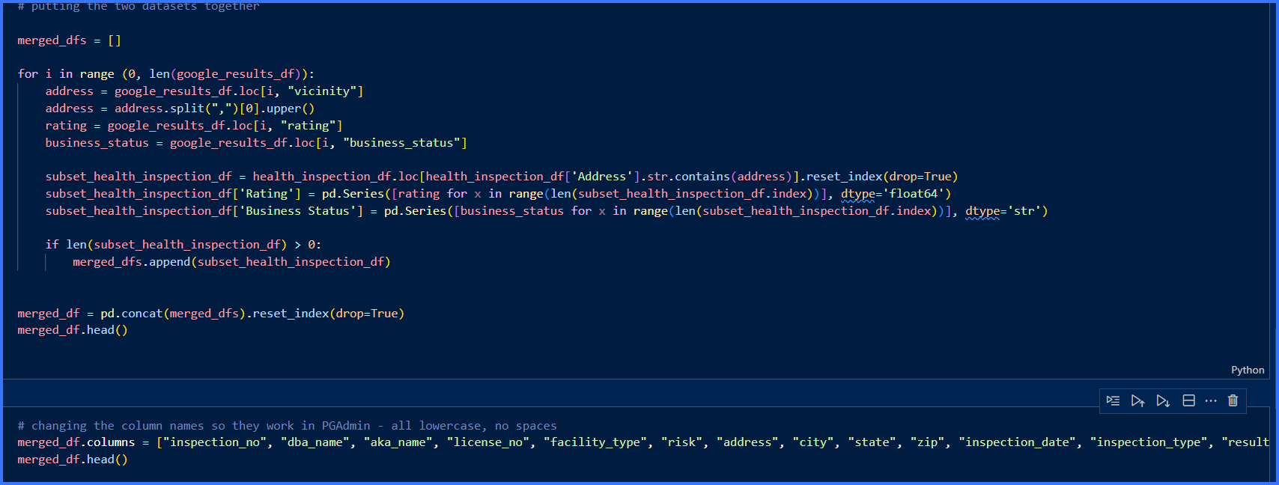
Joining Our Data Sources (cont.)
Notes:
We were able to match and join in Python and then looked at

Slide 15
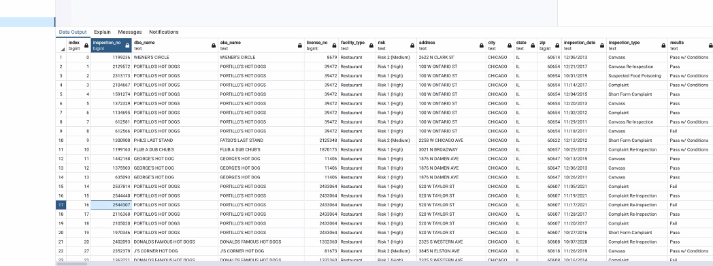
Data Analysis
Notes:
To do the comparative analysis, we spent a bit of time getting the data to load in PostgreSQL. This was quite a process! We used Python, PGAdmin and then queried customer ratings from the Google Places API, and looked at the risk scores and complaints by address.

Slide 16
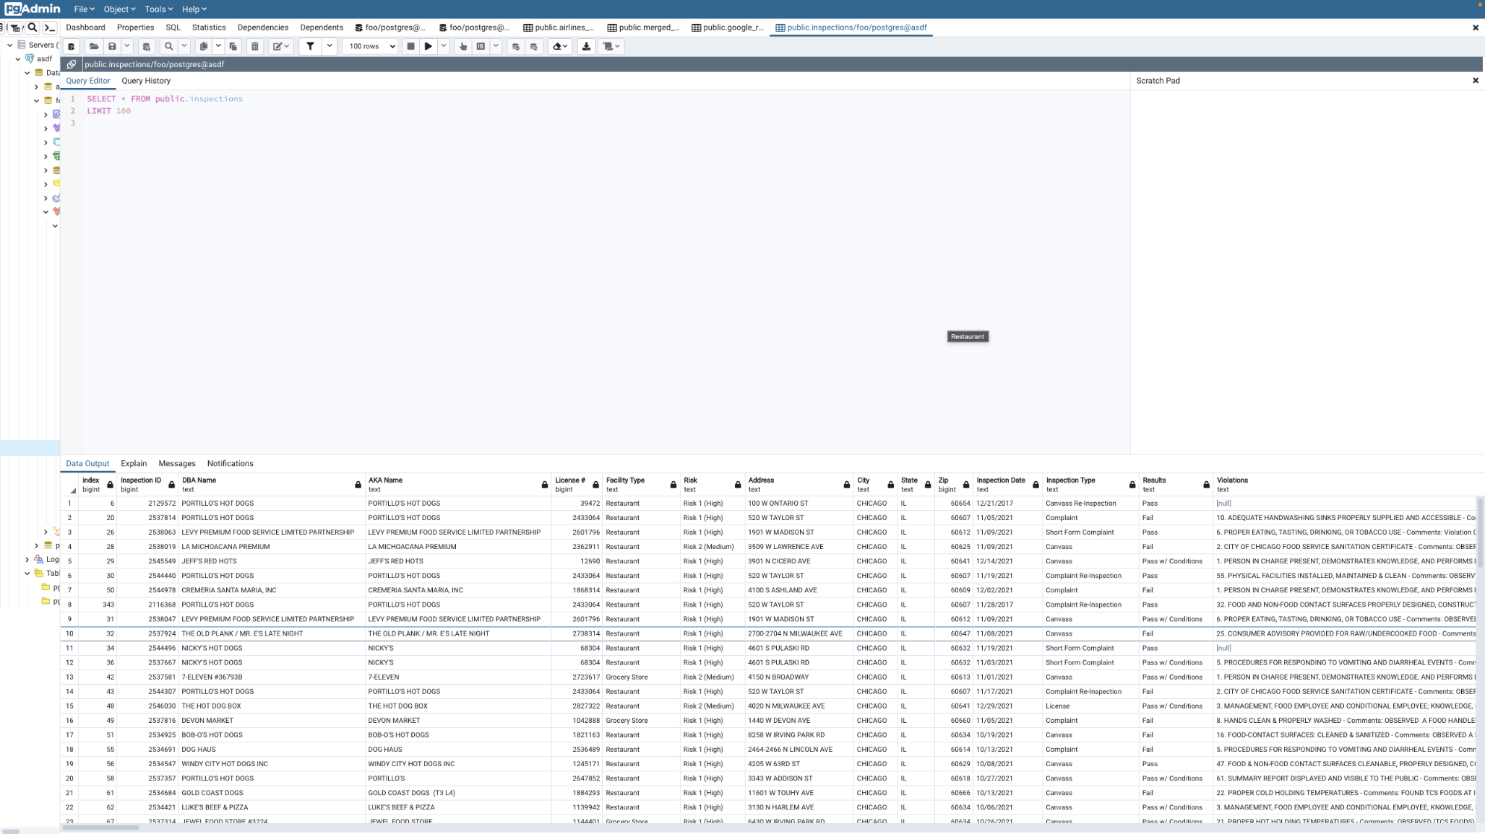
Data Analysis

Slide 17
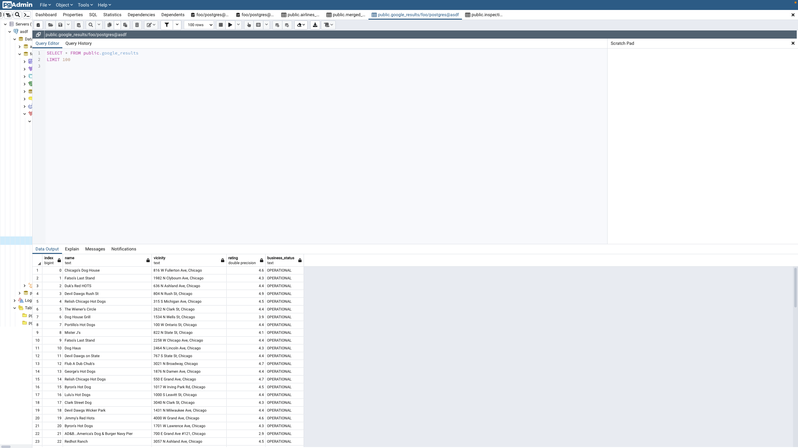
Data Analysis

Slide 18
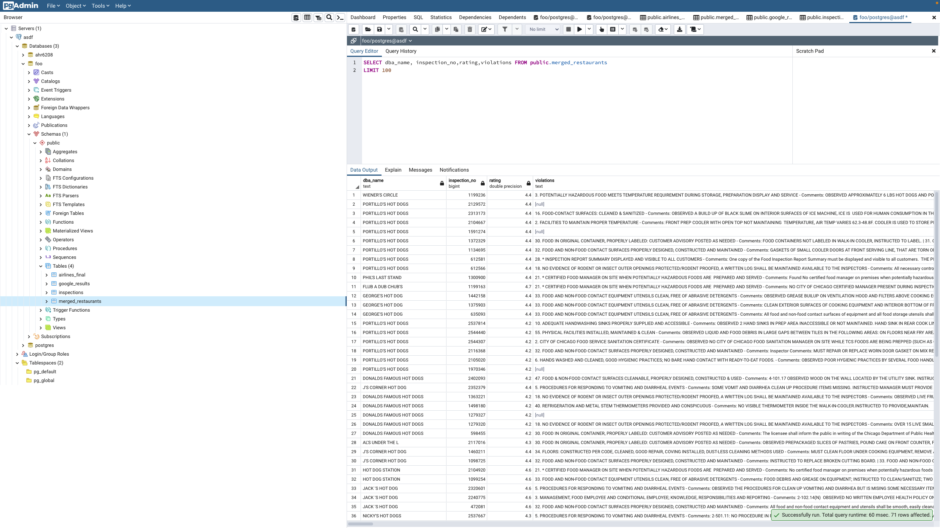
Data Analysis

Slide 19
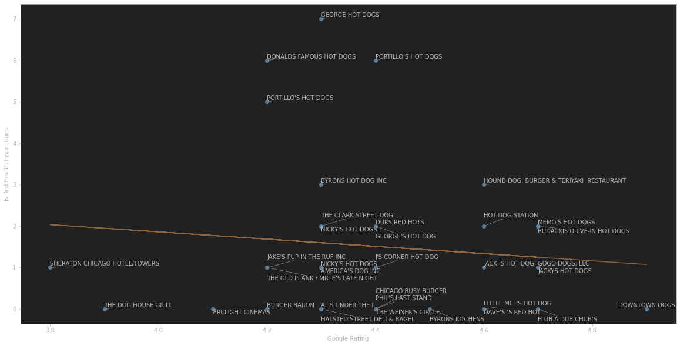
Data Analysis

Slide 20
Conclusion
We were able to merge our data sources successfully in Python
Using PostgreSQL to load our data, we could then query both sources for comparison
If we had more time, we could dig more into the correlations and see how closely they were related

Slide 21
Final Comments
Successes:
Package for PostgreSQL downloads
Challenges:
.csv files in PostgreSQL
Twitter searches
Lessons Learned:
Don’t look up inspection data for restaurants you really love…

Slide 22
Appendix

Slide 23
Data Resources
https://data.cityofchicago.org/widgets/4ijn-s7e5?mobile_redirect=true
Google Places API
Yelp.dataset.com
https://www.kaggle.com/datasets/ngshiheng/michelin-guide-restaurants-2021

Slide 24
References
Stack overflow
https://stackoverflow.com/questions/43886124/api-to-get-all-the-reviews-and-rating-from-google-for-business
https://stackoverflow.com/questions/69775792/loading-yelp-kaggle-dataset-on-google-colab-taking-too-long
https://stackoverflow.com/questions/55317894/how-to-sort-a-list-of-restaurant-names-by-restaurant-rating-possibly-from-googl/56403370#56403370
https://stackoverflow.com/questions/6965847/obtaining-more-than-20-results-with-google-places-api

Slide 25
References (cont.)
Quora
https://www.quora.com/What-is-the-best-API-source-for-access-to-a-restaurant-database
https://www.quora.com/unanswered/What-is-the-best-API-to-use-for-restaurant-search-without-incurring-too-much-cost
GitHub
https://github.com/zoehuang7/Yelp-Review-Analysis
https://github.com/twitterdev/
https://github.com/twitterdev/search-tweets-python
Twitter
https://developer.twitter.com/apitools
https://developer.twitter.com/en/docs/twitter-api/v1/tweets/search/guides/standard-operators
https://python-twitter.readthedocs.io/en/latest/

Slide 26
References (cont.)
StackAbuse
https://stackabuse.com/accessing-the-twitter-api-with-python/
PostgreSQL Tutorial
https://postgresqltutorial.com/postgresql-python/connect/
GeeksforGeeks
https://www.geeksforgeeks.org/postgresql-connect-to-postgresql-database-server-in-python/
https://www.geeksforgeeks.org/adding-new-column-to-existing-dataframe-in-pandas/
https://postgresqltutorial.com/postgresql-python/connect/
https://www.geeksforgeeks.org/postgresql-connect-to-postgresql-database-server-in-python/
https://towardsdatascience.com/load-yelp-reviews-or-other-huge-json-files-with-ease-ad804c2f1537

Slide 27
Acknowledgements
Prometheus- Greek god of numbers
rn gesus- Random Number Generator

